Slide 1
Introduction
Chapter 1

Slide 2
Uses of Computer Networks
Business Applications
Home Applications
Mobile Users
Social Issues

Slide 3
Business Applications
Resource Sharing: make all programs, equipment, and especially data available to anyone on the network regardless of their locations.
A company’s information system consists of:
Servers: powerful computers that store data
Clients: simpler computers representing employees
The client-server model is available for:
The client and the server are in the same building
Remote access

Slide 4
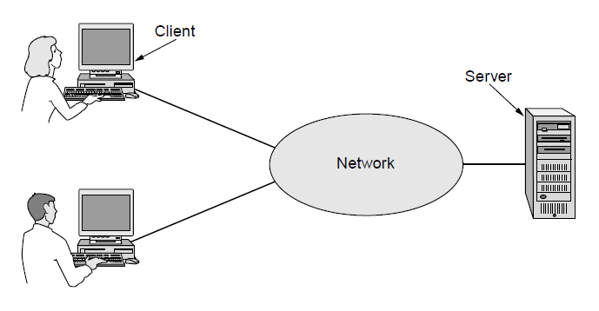
Business Applications
A network with two clients and one server

Slide 5
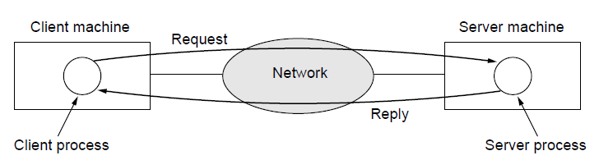
Business Applications
The client-server model involves requests and replies

Slide 6
Business Applications
Communication medium, e.g., email (electronic mail)
Voice over IP (VoIP)
Video conferencing
Desktop sharing
Cooperative document editing
Telemedicine
E-commerce

Slide 7
Home Applications
Internet access provides users with connectivity to remote computers to access information, communicate with other people, buy goods and services
Network effect: the value of a network is proportional to the square of the number of users (Metcalfe’s law)
Information access:
Online news
Online digital library, e.g., IEEE/ACM transactions
Personalized contents/content recommendation
The business model is usually online ads
Client-server model and peer-to-peer communication

Slide 8
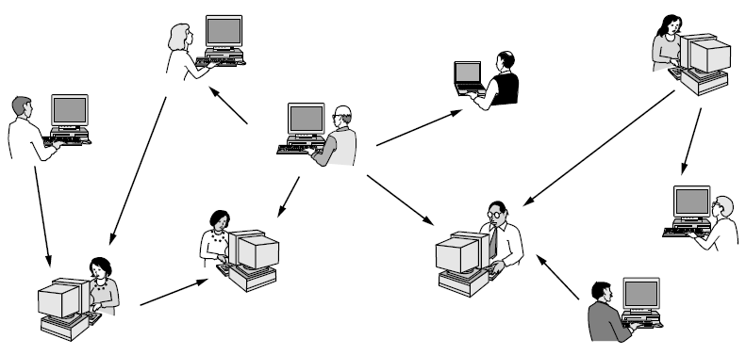
Home Applications
In a peer-to-peer system there are no fixed clients and servers.

Slide 9
Home Applications
Peer-to-Peer
No central database of contents
Each user maintains his own database locally and a list of contents
Copyright infringement issue: Napster, which enables music sharing

Slide 10
Home Applications
Person-to-Person
Email
Instant messaging
Multi-person messaging service, e.g., Twitter
Video sharing, e.g., YouTube
Social network
Facebook
Collaborative content creation
Wikipedia

Slide 11
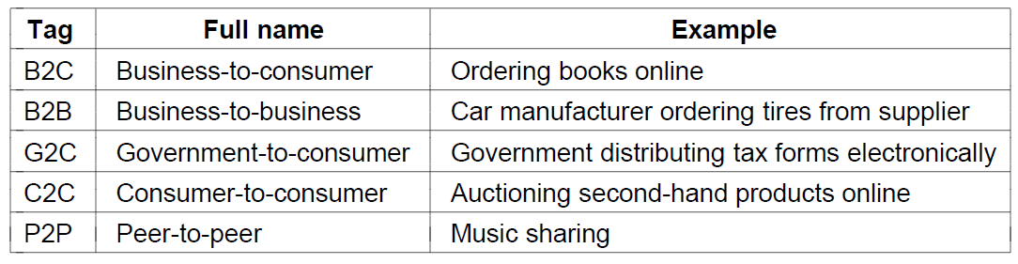
Home Applications
E-commerce
Some forms of e-commerce

Slide 12
Home Applications
Entertainment
IPTV
Based on IP technology instead of cable TV or radio transmission
Media streaming
Netflix
Interactive media
Interactive film
Interactive live television
Multiperson real-time simulation games

Slide 13
Home Applications
Ubiquitous computing
Smart home
Home security system
Consumer electronic devices
Smart phone
Smart watch
Smart band
Smart shoe
Smart garments
RFID
Replace barcodes
Internet of things

Slide 14
Mobile Users
Connectivity:
Cellular networks
  (almost) full coverage
  Higher cost
WiFi
  Partial coverage, hotspots
  Lower cost
Applications of wireless network
Users on-the-go
Taxi dispatcher
military

Slide 15
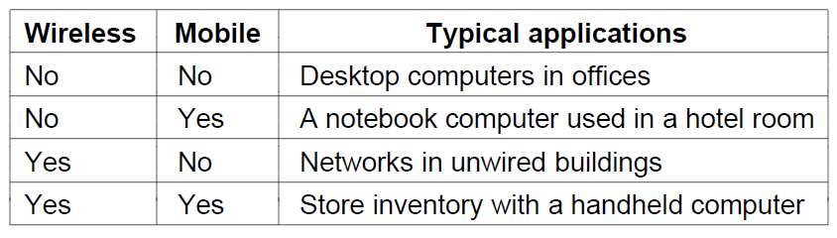
Mobile Users
Combinations of wireless networks and mobile computing

Slide 16
Mobile Users
Smartphone, key driver of mobile, wireless applications
Text messaging
Apps
Location-based services
Mobile phones equipped with GPS (Global Positioning System)
Recommend nearby restaurants, local weather forecast, annotate phones/videos with locations (geo-tag)
M-commerce (mobile-commerce)
Payments with mobile phones

Slide 17
Mobile Users
Sensor Networks
Sensor networks are made up of nodes that gather and wirelessly relay information about the state of the physical world.
Pollution monitoring
Farming
Military
Traffic monitoring
Animal migration tracking
Key issues: sensor nodes have limited energy, memory, computing power
Energy harvesting
Security
Efficient transmission

Slide 18
Social Issues
Network neutrality
Digital Millennium Copyright Act
Profiling users
Privacy and security

Slide 19
Social Issues
Network neutrality
Network operators should treat the traffic of different companies/applications the same
A big company who pays well may get good service, and small-time users get poor service
Communications should not be differentiated by their
Content (what about offensive and abusive contents?)
Source
Who is providing the content

Slide 20
Social Issues
Digital Millennium Copyright Act
Pirate contents in peer-to-peer networks
Automated systems that search and give warnings for contents that violate copyright laws
Hard to reliably catch copyright infringement

Slide 21
Social Issues
Privacy and Security
Employers spy on emails of employees
Government censorship
User profiling
Cookies of web browsers track users’ activities in cyberspace
Leak private information, e.g., credit card
Ad/goods/service recommendation
Location privacy of mobile users
Misleading information

Slide 22
Social Issues
Privacy and Security
Spam/junk mail
Criminal behavior
Virus
Phishing
Fake identity as a trustworthy party, e.g., your bank, to trick users to reveal sensitive information
Computer impersonating person
CAPTCHAS: ask a person to solve a short recognition task
Legal problems
Online gambling

Slide 23
Social Issues
Privacy and Security
Secure services
Encryption
  Encrypt the messages such that attackers cannot get the real information
Authentication
  Verify the identity of the source of the message
Integrity
  Verify that the messages are not modified

Slide 24
Network Hardware
Two types of transmission technology
Point-to-point links
Connect individual pairs of machines
From source to the destination through multiple intermediate machines connected by point-to-point links; multiple routes are possible
Unicasting: point-to-point transmission with exactly one sender and exactly one receiver
Broadcast links
All machines on the network share the communication channel

Slide 25
Network Hardware
Broadcast links
All machines on the network share the communication channel
Packets sent by a machine are received by all others
An address field specifies the intended receiver
  Receivers check the address field to decide whether to keep or ignore the message
A wireless network is a common example of broadcast links
Broadcasting/multicasting: addressing a packet to all or a subset of machines.

Slide 26
Network Hardware
Personal area networks
Local area networks
Metropolitan area networks
Wide are networks
The internet

Slide 27
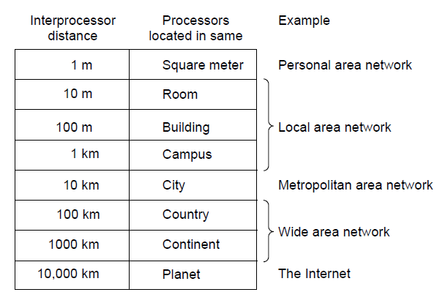
Network Hardware
Classification of interconnected processors by scale.

Slide 28
Network Hardware
Personal Area Network (PAN)
Devices communicate over the range of a person
For example, a wireless network that connects a computer with its peripherals via Bluetooth

Slide 29
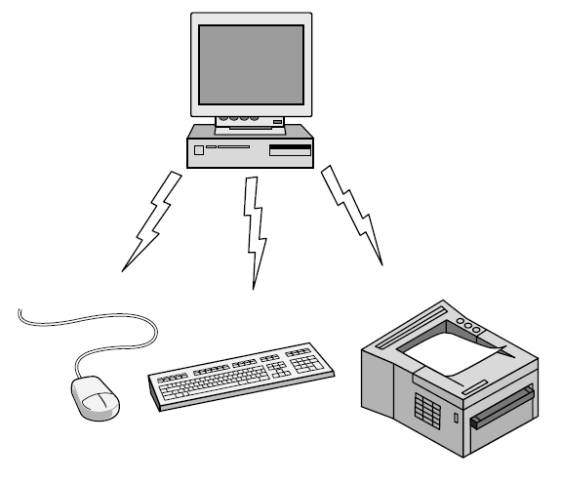
Personal Area Network
Bluetooth PAN configuration

Slide 30
Network Hardware
Personal Area Network (PAN)
A wireless network that connects a computer with its peripherals via Bluetooth
Bluetooth network uses the master-slave paradigm.
PC is the master; the mouse, the keyboard, etc., are slaves
The master tells the slaves what addresses to use, when to broadcast, how long to transmit, what frequencies to use
PANs can be built with other technologies, e.g., RFID

Slide 31
Network Hardware
Local Area Network (LAN)
A privately owned network that operates within and nearly a single building, e.g., a home, office, factory
Connect personal computers and consumer electronics for resource sharing and information exchange
Wireless LAN versus wired LAN

Slide 32
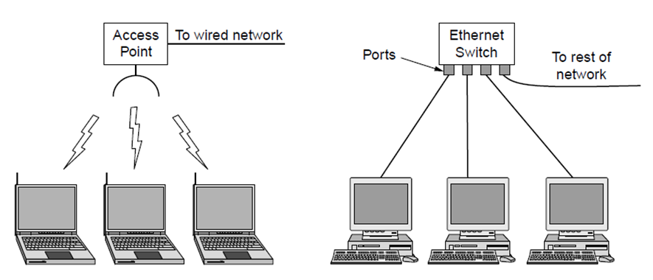
Local Area Networks
Wireless and wired LANs. (a) 802.11. (b) Switched Ethernet.

Slide 33
Network Hardware
Local Area Network (LAN)
Wireless LAN: IEEE 802.11, WiFi (informally)
In most cases, each computer talks to a device in the ceiling, called AP (access point), wireless router or base station
AP relays packets between the wireless computers and between them and the Internet
Wired LAN: IEEE 802.3, switched Ethernet
Point-to-point links
Each computer connects to a switch that has multiple ports, each connecting to a computer; the switch relays packets between computers
Wired LANs exceed wireless LANs in all dimensions of performance

Slide 34
Network Hardware
Local Area Network (LAN)
Wireless and wired broadcast LANs can be divided into static and dynamic designs
Static designs
Divide time into intervals and each user can transmit in his own time slot
Wasteful
Dynamic designs
Centralized: a single entity determines who to transmit by monitoring and prioritizing the packets of users
Decentralized: each user decides for themselves when to transmit, potential conflict

Slide 35
Network Hardware
Local Area Network (LAN)
Smart home scenario is a typical LAN
Networking computers, entertaining devices (e.g., TV), consumer electronics (smartphone), appliances (microwave oven), infrastructure (utility meter)
Key issues:
Easy to install
Compatibility
  No format wars. Different formats of technologies or technology update will not affect use
Low cost
Security and reliability

Slide 36
Network Hardware
Metropolitan Area Network (PAN)
Covers a city
Cable television networks
The incumbent cable TV network is modified to support two-way Internet service in unused parts of the spectrum
Both TV signals and Internet feed into the centralized cable headend for subsequent distribution to people’s homes

Slide 37
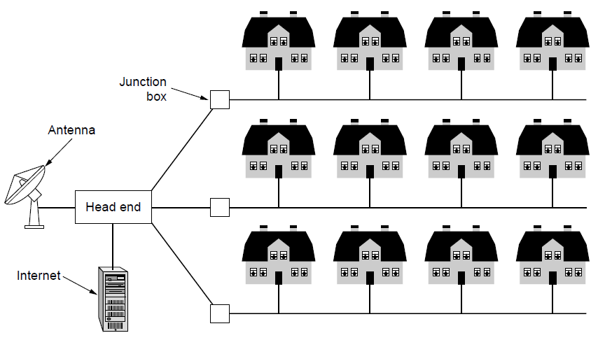
Metropolitan Area Networks
A metropolitan area network based on cable TV.

Slide 38
Network Hardware
Wide Area Network (WAN)
A large geographical area, often a country or continent
For example, a wired WAN for a company with branch offices in Perth, Melbourne and Brisbane
Each offices have computers that are called hosts
The rest of the network that connects the hosts are called subnets.

Slide 39
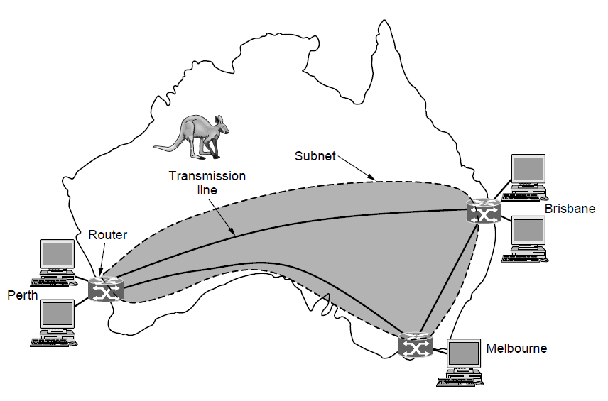
Wide Area Networks
WAN that connects three branch offices in Australia

Slide 40
Network Hardware
Wide Area Network (WAN)
The subnet consists of
Transmission lines
  Move bits between machines
  Copper wire, optical fiber or radio links
  Companies often lease transmission lines from telecommunications company
Switching elements/switches/router
  Connect two or more transmission lines
  Choose an outgoing line for an incoming line (routing)

Slide 41
Network Hardware
Wide Area Network (WAN)
Difference between WAN and a large wired LAN
In a WAN, the hosts (the application aspects) and the subnet (the communication aspects) are usually owned and operated by different entities.
  The hosts owned by employees
  The subnet is operated by the IT department of the company
In a WAN, the routers usually connect different kinds of networking technology.
  The networks inside the offices may be switched Ethernet
  The long-distance transmission lines may be SONET links

Slide 42
Network Hardware
Wide Area Network (WAN)
Two varieties of WAN
VPN is used instead of the dedicated transmission lines
The company does not lease the dedicated transmission lines but connects its offices to the Internet
VPN (Virtual Private Network): flexible reuse of Internet connectivity, lack of control of underlying resources, the capacity may vary

Slide 43
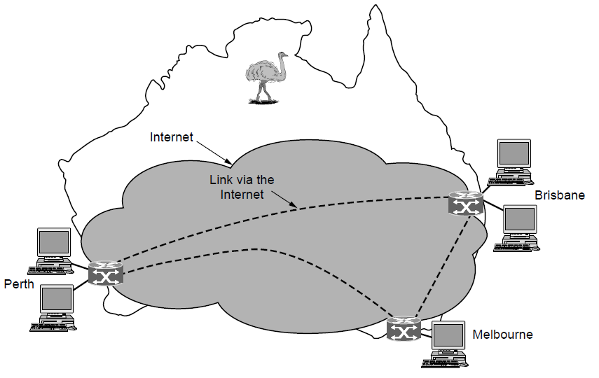
Wide Area Networks
WAN using a virtual private network.

Slide 44
Network Hardware
Wide Area Network (WAN)
Two varieties of WAN
Use an ISP network
The subnet is run by the ISP (Internet Service Provider)
The offices are connected to the subnet owned by the ISP

Slide 45
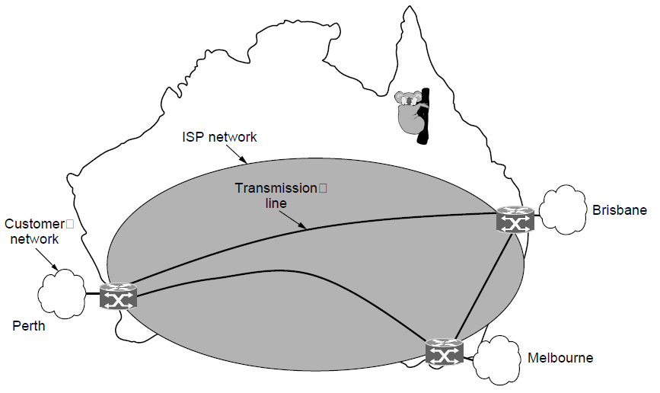
Wide Area Networks
WAN using an ISP network.

Slide 46
Network Hardware
Wide Area Network (WAN)
Routing problem
Two routers that do not share a transmission line wish to communication.
Routing algorithm: choose a path among many available paths between the two routers
Forwarding algorithm: each router decides where to send a packet next
Wireless technologies
Satellite WAN
Cellular network

Slide 47
Network Software
Protocol hierarchies
Design issues for the layers
Connection-oriented versus connectionless service
Service primitives
Relationship of services to protocols

Slide 48
Network Hardware
Protocol Hierarchies
Most networks are organized as a stack of layers
Each layer offers certain services to the higher layers but hiding the details of how the offered services are implemented
Protocol: an agreement between the communicating parties on how communication is to proceed
Layer n on one machine communicate with layer n on another machine through the layer n protocol
An analogy: a woman introduced to a man may choose to stick out her hand. He may decide to either shake it or kiss it, depending on whether she is a business partner or a princess at a formal ball

Slide 49
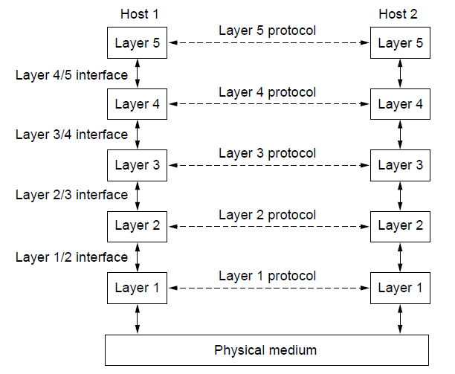
Protocol Hierarchies
Layers, protocols, and interfaces.

Slide 50
Network Hardware
Protocol Hierarchies
Virtual communication (dotted line): no data are directly transferred from layer n on one machine to layer n on another machine
Physical communication (solid line): each layer passes data and control information to the layer immediately below it; below layer 1 is the actual communication through the physical medium
Peer: the entities of the same layer on different machines

Slide 51
Network Hardware
Protocol Hierarchies
Interface
Between each pair of adjacent layers
Define which primitive operations and services the lower layer makes available to the upper one
Each layer perform a specific collection of well-understood functions
Clear-cut interfaces make it easier to replace one layer with a completely different protocol or implementation without affecting the layers above it

Slide 52
Network Hardware
Protocol Hierarchies
Network architecture
A set of layers and protocols
Not include interfaces
Protocol stack: a list of protocols used by a certain system, one protocol per layer

Slide 53
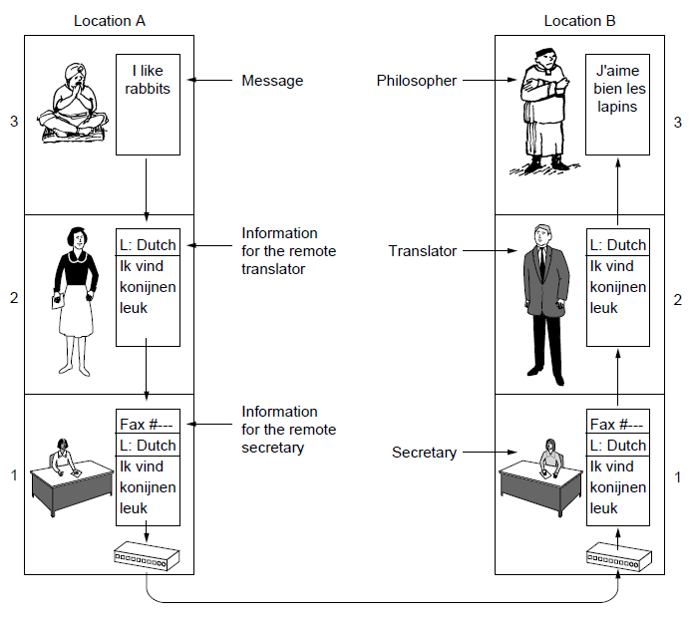
Protocol Hierarchies
The philosopher-translator-secretary architecture

Slide 54
Network Hardware
Protocol Hierarchies
An analogy: multilayer communication
Two philosophers (layer 3), one only speaking English, the other only speaking French, no common language
Each philosopher hires a translator (layer 2)
Each translator hires a secretory (layer 1)

Slide 55
Network Hardware
Protocol Hierarchies
Communication process
Philosopher 1 passes a message in English across the 2/3 interface to translator 1
The translators have agreed on a common language Dutch (layer 2 protocol). Translator 1 translates the message to Dutch
Translator 1 passes the message in Dutch to Secretory 1 through the 1/2 interface
The secretary have agreed on a common exchange method email (layer 3 protocol). Secretory 1 sends the message through email to Secretory 2
Secretory 2 passes the message to Translator 2 via the 2/1 interface; Translator 2 passes the message to Philosopher 2 via the 3/2 interface

Slide 56
Network Hardware
Protocol Hierarchies
Each protocol is independent of the others
The translators can switch to Chinese
The secretory can switch to fax
Each layer may add additional information intended only for its peer, invisible to the higher layers

Slide 57
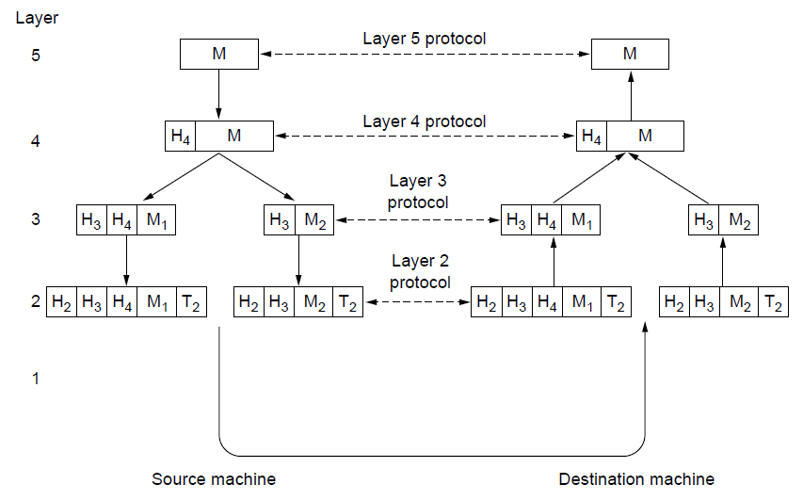
Protocol Hierarchies (3)
Example information flow supporting virtual
communication in layer 5.

Slide 58
Network Hardware
Protocol Hierarchies
Communication in a five-layer network
Layer 5 generates M and passes it to layer 4
Layer 4 adds a header H4 and passes it to layer 3, the header may include control information, e.g., addresses, sequence numbers, sizes, timestamp
Layer 3 has a limit on the size of messages so that layer 3 divide M into smaller units M1 and M2, adding headers to each one, and passes them to layer 2
Layer 2 adds a header and a trailer (e.g., for error detection and correction) and passes it to layer 1 for physical transmission
At the receiver, the message moves up layer by layer with headers stripped off. No headers below layer n will be passes up to layer n

Slide 59
Network Hardware
Protocol Hierarchies
Virtual versus actual communication
Layer 4 peers conceptually think they communicate horizontally via layer 4 protocol
Layer 4 peers actually talk through all the layers below them

Slide 60
Network Hardware
Protocol Hierarchies
Design Issues
Reliability
Error detection and error correction: transmitted bits may be damaged due to electrical noise, hardware flaws, software bugs; make a network operate correctly; add redundancy
Routing: some links or routers may be broken; find a working path through a network

Slide 61
Network Hardware
Protocol Hierarchies
Design Issues
Network evolution/growth
Addressing/naming: identify the senders and receivers
Internetworking: heterogeneous networks, e.g., different maximum size of message
Scalability: large network gets congested

Slide 62
Network Hardware
Protocol Hierarchies
Design Issues
Resource allocation
Divide resources, e.g., bandwidth among hosts
Statistical multiplexing: share bandwidth based on statistics of demand of different hosts
Flow control: prevent a fast sender from flooding a slow receiver
Congestion: too many users in the network
Quality of service (QoS) is a measurement to evaluate the performance of resource allocation

Slide 63
Network Hardware
Protocol Hierarchies
Design Issues
Security
Confidentiality: prevent attackers from eavesdropping
Authentication: verify the identity of the senders and receivers
Integrity: verify that the messages are not tampered with

Slide 64
Network Hardware
Protocol Hierarchies
Connection-oriented vs Connectionless service
Connection-oriented (the telephone system)
Establish a connection (dial up), use the connection (talk), then release the connection (hang up)
The sender and the receiver negotiate the parameters of the link, e.g., maximum message size
In most cases, the order of transmitted bits is preserved
Connectionless (the postal system)
Send many letters, each with the full destination address
Each message (letter) is routed through the system independently in the network
The transmitted packets may be out of order

Slide 65
Network Hardware
Protocol Hierarchies
Each service can be divided according to reliability
Reliable services are attained by having the receiver acknowledge the receipt of each message; add overhead and delay
Reliable connection-oriented service: file transfer
Bits arrive correctly and in order
Message sequences: message boundaries are preserved, e.g., book
Byte streams: no message boundaries, e.g., movie
Unreliable connection-oriented service: Voice over IP
A bit of noise is less disrupted than the delay of acknowledgement

Slide 66
Network Hardware
Protocol Hierarchies
Reliable connectionless service: text message
Acknowledged datagram service
Like sending a registered letter and requesting a receipt
Unreliable connectionless service: spam
Unreliable datagram service
Send numerous spams that has a high probability of arrival but no guarantee
Request-reply service: database query
The sender sends a single datagram containing a request
The reply contains the answer
Client-server model

Slide 67
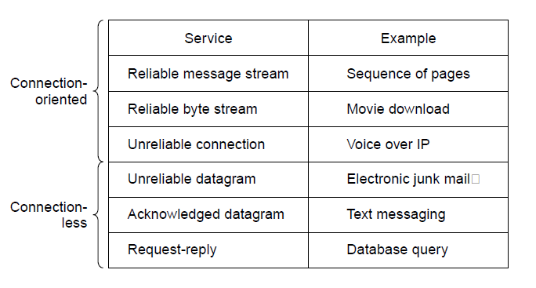
Connection-Oriented Versus
Connectionless Service
Six different types of service.

Slide 68
Network Hardware
Protocol Hierarchies
Reliable versus unreliable
Reliable service is not available in some layers
Reliable service has a longer delay, not acceptable to some real-time services

Slide 69
Network Hardware
Service Primitives
Primitives (operations): tell the service to perform some action or report on an action by a peer
Primitives of different services are different
Example: primitives for a reliable byte stream

Slide 70
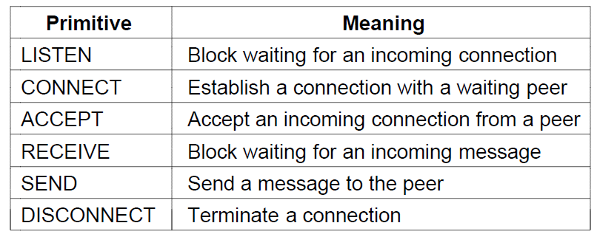
Service Primitives
Six service primitives that provide a simple
connection-oriented service

Slide 71
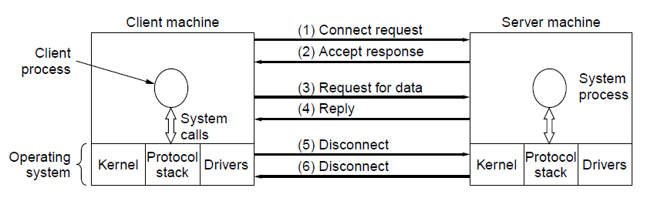
Service Primitives
A simple client-server interaction using
acknowledged datagrams.

Slide 72
Network Hardware
Service Primitives
Server executes LISTEN (a manager sits by his telephone to wait for a call)
Client executes CONNECT to establish a connection with Server (a customer calls); the client process is suspended to wait for reply
Server executes ACCEPT (the manager picks up the phone); a connection is established
Server executes RECEIVE to prepare to accept the request immediately being released from LISTEN
Client executes SEND followed by RECEIVE
Server executes SEND to return the answer
Client executes DISCONNECT
Server executes DISCONNECT

Slide 73
Network Hardware
Service Primitives
Potential issues:
The reply contains hundreds of packets, some of which may get lost
How would the client know if some packets were missing?
How would the client know whether the last packet received was really the last packet?
Suppose the client wanted a second file. How could the client tell packet 1 from the second file from a lost packet 1 from the first file that suddenly found its way to the client?
These will be resolved by protocols introduced later in the course

Slide 74
Network Hardware
Services vs Protocols
Services: a set of primitives (operations) that a layer provides to the layer above it; says nothing about how these operations are implemented
The secretary handles message delivery for the translator but does not tell him how the message is sent (via mail or fax)
Protocol: a set of rules governing the format and meaning of the packets, or messages that are exchanged by the peer entities within a layer
The two translators agree on using Dutch for communication

Slide 75
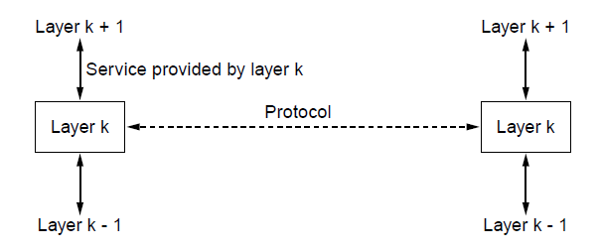
The Relationship of Services to Protocols
The relationship between a service and a protocol.

Slide 76
End
Chapter 1

